Slide 1
ABDUL RAZZAK MARAICAR K
B.TECH.AI/DS
SINCET
NM ID:au821721243001
NAAN MUDHALVAN PROJECT

Slide 2

Microsoft Stock Price Prediction Using Machine Learning

Slide 3


AGENDA:
Problem statement
Project overview
Who are the end users?
Your solution and its value proposition
The vow in your solution
Modelling
Results
3/21/2024 Annual Review

Slide 4

PROBLEM STATEMENT: A concise problem statement for stock price prediction could be: "Develop a predictive model to forecast the future price movements of a given stock based on historical price data, market indicators, and relevant external factors. The objective is to provide accurate and actionable predictions that can assist investors in making informed trading decisions and managing their portfolios effectively."

Slide 5

PROJECT OVERVIEW
1.Objective Definition
2.Data Collection and Preprocessing
Feature Selection and Engineering
Model Selection
Model Training
Model Evaluation
Model Testing and Deployment
You

Slide 6

WHO ARE THE END USERS?
1.Investors
Traders
Financial Analysts
Portfolio Managers
Financial Advisors
Market Researchers
Algorithmic Trading Systems
Microsoft Stakeholders

Slide 7

SOLUTION:
Solution: Utilizing advanced machine learning and data analysis techniques, we develop robust predictive models that forecast future movements in stock prices for Microsoft and other companies.
Our solution involves:
Data Collection and Analysis: We gather extensive historical data on stock prices, market indicators, and relevant external factors. This data is meticulously analyzed to identify patterns and trends that can inform our predictive models.
Model Development: Our team of experts constructs sophisticated predictive models using machine learning algorithms such as regression, time series analysis, and deep learning. These models are trained on historical data to learn patterns and relationships, enabling them to make accurate predictions about future stock price movements.

Slide 8
Value proposition:
Value Proposition: Our stock price prediction solution offers several key benefits to investors, traders, financial professionals, and other stakeholders:
Enhanced Decision-Making: By providing accurate forecasts of stock price movements, our solution empowers users to make informed investment decisions, optimize trading strategies, and mitigate risks effectively.
Improved Performance: Our predictive models leverage advanced analytics and machine learning algorithms to deliver superior performance compared to traditional forecasting methods. This enables users to achieve higher returns and better portfolio outcomes.

Slide 9

THE VOW IN YOUR SOLUTION
The "vow solution" in stock price prediction might refer to a specific methodology, algorithm, or approach used to forecast stock prices. While I'm not aware of a specific method called the "vow solution" in this context, I can provide a hypothetical outline of what such a solution might entail:
VOW Solution in Stock Price Prediction:
Variable Selection: Identify key variables that have a significant impact on stock prices. This may include historical price data, trading volume, market sentiment indicators, technical indicators, and fundamental factors such as earnings, revenue, and macroeconomic indicators.
Optimization Techniques: Utilize advanced optimization techniques to fine-tune model parameters and improve prediction accuracy. This may involve techniques such as grid search, random search, or Bayesian optimization to find the optimal configuration for the predictive model.
Weighted Forecasting: Implement a weighted forecasting approach that assigns different weights to individual predictors based on their historical performance and relevance. This allows the model to adapt to changing market conditions and prioritize the most influential factors in the prediction process.

Slide 10
MODELLING:
When modeling for stock price prediction, it's essential to use techniques that can capture the complex dynamics of financial markets. Here's a general approach to modeling for stock price prediction:
1. Data Collection and Preprocessing:
- Gather historical stock price data, market indices, and relevant financial indicators.
- Preprocess the data by handling missing values, outliers, and normalization.
2. Feature Engineering:
- Select relevant features such as historical prices, trading volume, technical indicators (e.g., moving averages, Relative Strength Index), and fundamental factors (e.g., earnings, dividends).
- Engineer new features or transformations to enhance model performance.
3. Model Selection:
- Choose appropriate modeling techniques such as:
- Linear Regression: Simple and interpretable, suitable for capturing linear relationships.
- Time Series Models: Autoregressive Integrated Moving Average (ARIMA), Seasonal Autoregressive Integrated Moving-Average (SARIMA), or Exponential Smoothing (ETS) models for capturing time-dependent patterns.
- Machine Learning Models: Decision trees, Random Forests, Gradient Boosting Machines (GBM), Support Vector Machines (SVM), or Neural Networks for capturing nonlinear relationships and complex patterns.
- Deep Learning Models: Recurrent Neural Networks (RNNs), Long Short-Term Memory (LSTM) networks, or Gated Recurrent Units (GRUs) for sequential data like time series.
- Consider ensemble methods to combine predictions from multiple models for improved accuracy and robustness.
4.Model Training:
- Split the data into training and validation sets.
- Train the selected models using the training data, adjusting hyperparameters as necessary.
- Validate models using the validation set and iterate on model selection and tuning as needed.

Slide 11
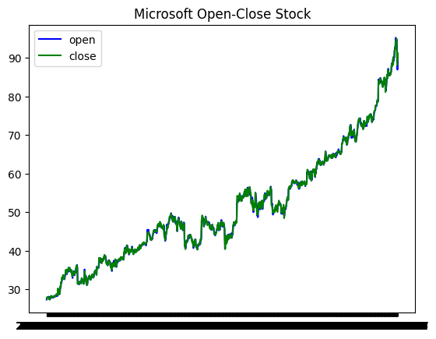
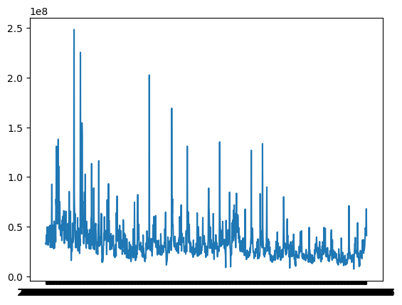
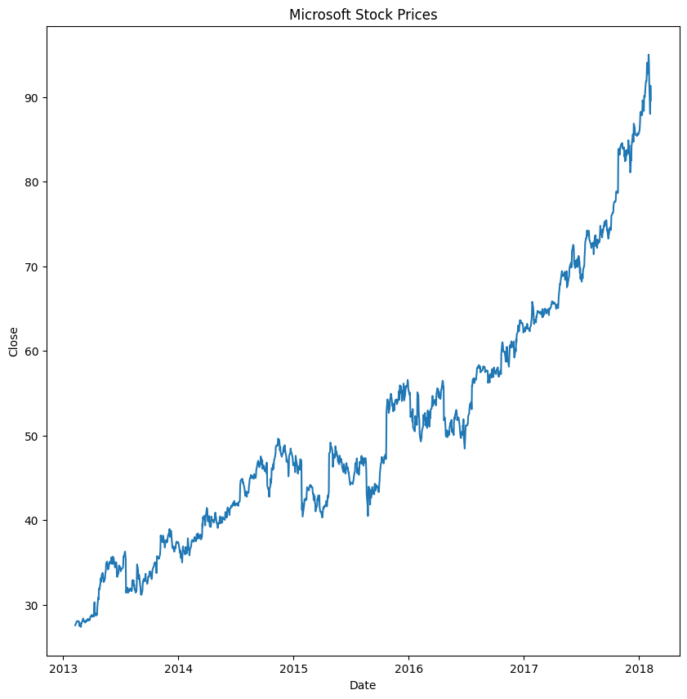
RESULTS:

